Slide 1
Risk Identification and
Prediction for Long COVID
Emma Jin, Elliot Kim, Victoria Song
CPSC 66 (Fall 2021)

Slide 2
Introduction
Long COVID: persistence of symptoms post-COVID-19
Our dataset: Headaches, Fatigue, Shortness of breath, Anxiety, Heart problems, Muscle aches, Dizziness
Goals: build a classifier for long COVID and identify risk factors of long COVID
Gender: Women have 2x likelihood compared to men (Nabavi, 2020)
Age: Mean age of long COVID patients = mean of non-long COVID patients + 4 (Nabavi, 2020)
Comorbidities (Osmanov et al., 2021)
Dataset: COVID-19 Fall 2020 & Winter 2021 Community Supplement, MCBS (Medicare Current Beneficiary Survey)
5 Most Common Symptoms (López-León et al., 2021)
Fatigue (58%)
Headache (44%)
Attention disorder (27%)
Hair loss (25%)
Shortness of breath (24%)
Prevalence (Carfì et al., 2020)
35% of COVID outpatients
87% of inpatients
1-2 symptoms: 32%
3+ symptoms: 55%
Notes:
ELLIOT
Long COVID is an increasingly familiar phenomenon where patients who have recovered from COVID-19 still experience lingering COVID symptoms. The five most common are fatigue, headache, attention disorder, hair loss, and shortness of breath, but the wide range of symptoms also include muscle pain, sleep problems, and cardiological problems.
Although many COVID patients experience complete recovery, a large subpopulation of patients experience sustained symptoms, especially in the outpatient and inpatient populations, with 87% of those hospitalized for COVID-19 experiencing long COVID. (That 87% can be broken down into 32% of inpatients who experience 1-2 symptoms, while 55% experience more than 3 sustained symptoms.)
The debilitating nature and prevalence of long COVID make it a pressing problem that will continue into a post-pandemic world. Early research has found a number of potential demographic and clinical risk factors. Our project to build a classifier for long COVID and identify long COVID risk factors uses Medicare (MCBS) data that also includes information about patient access and interaction with the healthcare, along with demographic and clinical information.

Slide 3
TABLE OF CONTENTS
01
02
03
Data Pre-
Processing
Building our Model
Analyzing Risk Factors
Feature selection and extraction
Build a classifier that accurately classifies whether a patient has long COVID
Identify the most defining risk factors for long COVID
Notes:
ELLIOT
Our project takes advantage of machine learning models to identify risk factors from an extensive dataset. This would be extremely difficult to do manually, but we take advantage of the fact that high feature importance in a machine learning model can be indicative of an important risk factor. Today, we will discuss
Data pre-processing: where we performed feature selection and extraction according to our chosen problem
Model building: where we build a classifier that predicts whether a COVID patient is indicated to experience long COVID.
Risk factor analysis: where we assess the risk factors of highest importance according to our classifier.

Slide 4
01
Pre-Processing Data

Slide 5
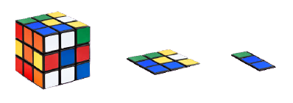
Dimensionality reduction
Feature selection
Feature extraction
Discard noisy or useless features
For example…
The user_id of the subject
The week in which the subject completed the survey
Produce a new set of features from the old ones
For example…
Do experts recommend hand-washing?
… wearing masks?
… avoiding gatherings?
… staying at home?
… medical attention for
short breath?
Knowledge of COVID measures recommended by experts
We also discarded features that are shown to have trivial importance
Notes:
After joining the two datasets and filtering out patients who were never infected with COVID, we had 901 examples but more than 300 features. So we decided to perform dimensionality reduction.
First, we did feature selection, where we discarded noisy features, such as the user_id and the week when the subject completed the survey, which aren’t really logical contributors to the label. Then, after training our model and acquiring the feature importances, which we’ll talk about in detail later, we found about 20 features that consistently have extremely low or zero importance, so we discarded those as well.
Next, we noticed in our dataset that there are many redundant or overly detailed features. For example, there were a set of feature asking patients to answer whether a measure is recommended by experts or not. We decided to combine these features into one feature that’s a score of the subject’s knowledge of expert-recommended measures.
By the end of dimensionality reduction, we had reduced to 51 features for 901 examples

Slide 6


Resampling the data
Notes:
Out of the 901 examples, we discovered a severe class imbalance. There were 615 patients with long COVID and only 286 patients without long COVID. To combat this, we decide to resample our data.

Slide 7
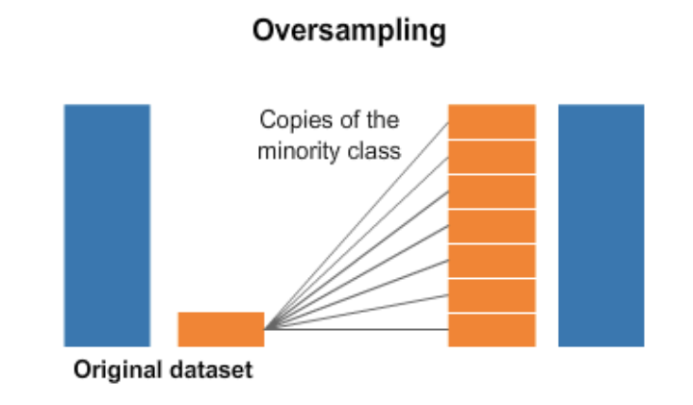
upsampling/
Oversampling
It’s important to note that we’re only performing upsampling on the training set!
Our testing set stays the same
Notes:
There are two kinds of resampling: upsampling and downsampling. Upsampling generates more instances of the minority class, while downsampling cuts down on instances of the majority class.
For the purposes of this project, we hope to at least preserve the original number of examples, since our dataset is not large, so we choose to use upsampling, which generates more instances of “patients” without long COVID in a way that’s consistent with the original data.
It’s also important to note that we’re only performing upsampling on the training set and we’re leaving the testing set the same!

Slide 8
02
Building Our Model
Notes:
After processing our data, we moved on to building our model.

Slide 9
Table: Accuracy of Different Models
 | Initial Model Accuracy | Avg Tuned Testing Accuracy
Logistic Regression | 0.660 | 0.686
Decision Tree | 0.626 | 0.624
Random Forest | 0.723 | 0.720
SVM | 0.668 | 0.693
Naive Bayes | 0.618 | 0.654
Notes:
To select the classifier with the best performances, we trained our data on a variety of models that are known to perform well on binary labels and categorical features, including Logistic Regression, Decision Tree, Random Forest, SVM and Naive Bayes. Here is a table showing the initial model accuracy after a hold our validation and the avg testing accuracy after tuning.And from the table, we can see that Random Forest has the best results and it is what we picked as our final classifier.

Slide 10
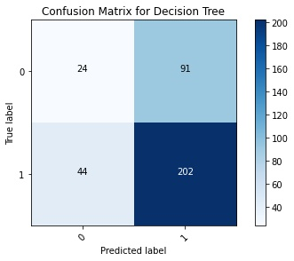
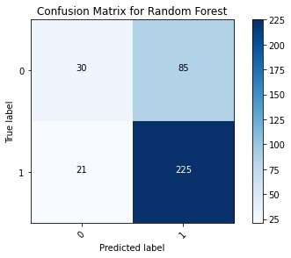
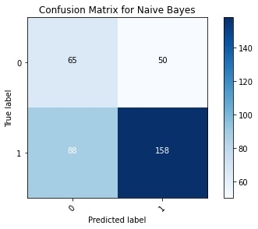
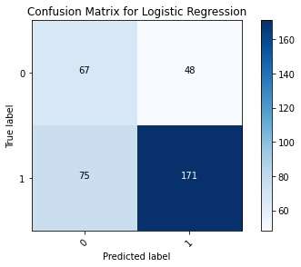
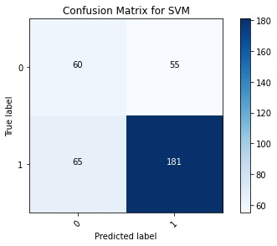
confusion Matrices After Tuning
Notes:
Aside from accuracies, we also examined the confusion matrices of our models. And we discovered that all of our models were a bit aggressive in predicting non-long COVID patients to be long COVID patients.For, there are far more false positives than true negatives.

Slide 11
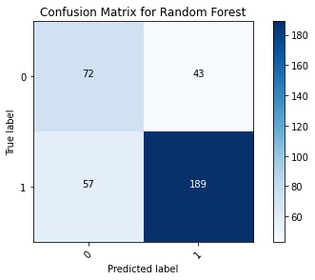
Tuning on precision
number of estimations = 75, max depth = 5, max leaf nodes = 15, max leaf nodes = 15, max features = 50% and min samples leaf = 25
Performing a hold-out validation on this model yields accuracy = 0.723, precision = 0.815, recall = 0.768, and f1-score= 0.791
Notes:
Therefore, we decided to tune more on precision. We plotted the validation curves of 5 hyperparameters of Random Forest and adjusted them to boost precision while maintaining our accuracy. And here we are showing what we choose as values for the hyperparameters for our model. And our precision reached 0.815 while our accuracy is at 0.723.

Slide 12
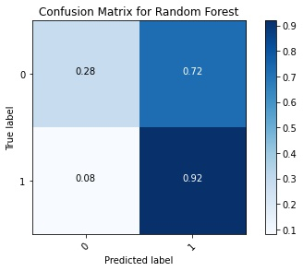
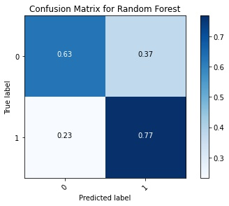
Normalized confusion matrix
Notes:
And here is the comparison of the two normalized confusion matrices for our random forest model before and after we tuned on precision. Since our testing set is still highly imbalanced, we can see the improvement more clearly from these two figures. Our false positive percentage ratio decreased and our true negative percentage ratio increased significantly.

Slide 13
03
Analyzing Risk Factors
Notes:
After successfully building our model, we generated the risk factors from feature importances of our random forest classifier.

Slide 14

Gini importance for random forests
The Gini importance for a feature θ is defined as:
The total decrease in node impurity when θ is chosen to split the node , averaged over all trees in the forest
Notes:
We thought that we could identify the most defining risk factors of long COVID by looking at the weights, or importances of features in our trained model.
The measure that we used is called the Gini importance for the random forest.
Recall how for decision trees, we learned about how to calculate the “Gini impurity”. For the random forest, the gini importance of a feature is basically the total decrease in impurity at a node when this feature is chosen to split samples at the node, averaged over all trees in the forest. This is why gini importance is also sometimes referred to as “mean decrease of impurity”.
For this project, we acquired the gini importance from an attribute of our random forest classifier from scikit learn, since it had already been calculated during the training of our classifier.

Slide 15
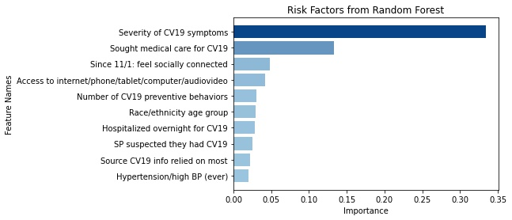
Identifying risk factors
Severity of CV19 Symptoms
Sought Medical Care for CV19
Notes:
This is the bar chart we ultimately generated after sorting the gini feature importances from our model. The first most important risk factor is the severity of COVID 19 symptoms the patient experienced while infected with COVID, and the second one is whether the patient sought medical care for COVID 19.
If we train the model multiple times without a random state, then we also get slightly varying results for the feature importances, but the first two always stays the same and leads by a relatively large margin.

Slide 16
Percentages by value
Notes:
ELLIOT
At this point, our model has helped us determine which features are the most important for long COVID prediction, namely “Severity of COVID-19 symptoms” and “Sought medical care for COVID-19.” However, for this to be of any clinical use, it’s critical to know how the specific feature values map to specific classes. Thus, we looked at the percentages of classes by feature value (PBVs)

Slide 17
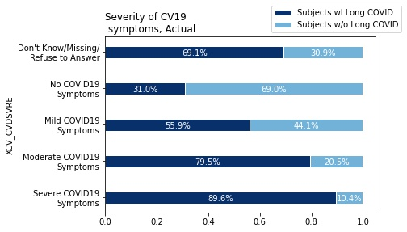
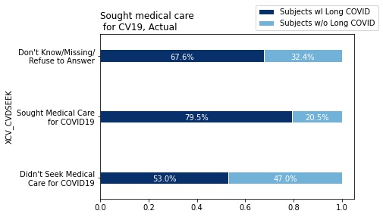
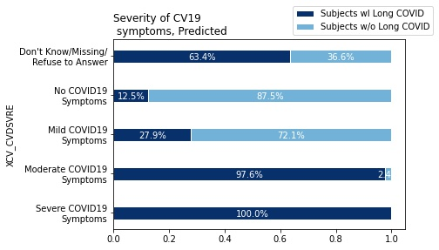
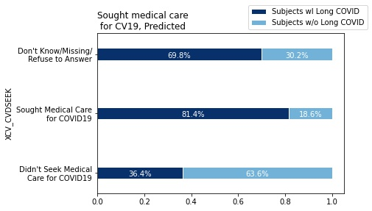
Percentages by Value
Notes:
ELLIOT
, or in other words:
on the left, the percentage of long COVID and non-long COVID patients by severity of COVID-19 symptoms, and
on the right, the percentage of long COVID and non-long COVID patients by whether patients sought medical care or not for COVID-19.
We did this for both the true labels and the predicted labels.
This way, we can not only observe how these risk factors correlate to long COVID outcomes, but also validate the performance of our model by comparing the predictions with the actual outcomes.
So if we look at the PBVs of “Severity of COVID-19 symptoms" for the actual labels, we can clearly see a direct relationship between symptom severity and incidence of long COVID. And if we look at how our model predicted long COVID outcomes based on symptom severity, we can see that direct relationship reflected in our model’s behavior. It does appear to classify fairly aggressively along this particular feature, which is consistent with the outstanding Gini importance of symptom severity.
In a similar manner, we can analyze our model’s second-most important feature: whether patients sought medical care for COVID-19. Here, we see that patients who seek medical care for COVID-19 are more strongly correlated with long COVID, but this is probably due to patients with more severe symptoms being more likely to seek medical care for COVID-19, and as we learned about symptom severity, these patients are more likely to experience long COVID.
Our reasoning here is actually reinforced by the fact that most patients who didn’t seek out medical care for COVID-19 didn’t do so because their symptoms were not severe, and it is not unreasonable to believe the inverse is true.

Slide 18
Conclusion
Random Forest Classifier with 0.723 accuracy and 0.815 precision
Most prominent risk factors: “Severity of COVID-19 Symptoms” and “Sought medical care for COVID-19”
More severe COVID symptoms ⇒ greater likelihood of long COVID
Patients who sought medical care for COVID are more likely to have long COVID
Patients can still get long COVID with mild or even no COVID symptoms.
Notes:
To conclude, we built a random Forest Classifier to predict for long COVID that yields decent accuracy and precision.
And, by looking at the feature importances, we discovered that the Severity of COVID-19 Symptoms” and “whether a patient sought medical care or not for COVID” are the most prominent risk factors.
And, from the PBVs, we found that the more severe the COVID symptoms are, the more likely a patient is going to suffer from long COVID and patients who actually sought medical care for COVID are more likely to get long COVID, which is likely an indicator for severity of covid19 symptoms.
And, we also found that there is a over 30 percent likelihood that patients who exhibited mild or even no symptoms can still get long COVID.

Slide 19
Conclusion
Implications
Reinforce the importance of existing research dedicated to preventing and minimizing severe COVID-19.
Indicate potential need for public health messaging to emphasize risk of long COVID even for patients with no or mild COVID symptoms
Future Directions
Develop more ways to alleviate severe COVID
Reconsider definition of “fully recovered from COVID-19”
Notes:
And base on our findings, we can conclude that our results reinforce the importance of existing research dedicated to preventing and minimizing severe COVID-19. And, our findings also indicate there could be a potential need for a shift in public health messaging to emphasize risk of long COVID even for patients with no or mild COVID symptoms.
As for future directions, we believed that future research can focus on developing more ways to alleviate severe covid and reconsidering the definition of “fully recovered from COVID-19”.

Slide 20
REFERENCES
Nisar, Riddhi. “(Visually) Interpreting the Confusion-Matrix: | by Riddhi Nisar | Analytics Vidhya | Medium.” Medium, Analytics Vidhya, 1 Nov. 2020, https://medium.com/analytics-vidhya/visually-interpreting-the-confusion-matrix-787a70b65678.
Chen, Denise. “Statistical Learning: Data Sampling & Resampling.” Medium, Towards Data Science, 12 Apr. 2020, https://towardsdatascience.com/statistical-learning-ii-data-sampling-resampling-93a0208d6bb8.
“320000+ Environmental Cartoons Images, HD Pictures and Stock Photos for Free Download.” LovePik, https://lovepik.com/images/environmental-cartoons.html.
Mahendrakumaran, Kayathiri. “Dealing with Imbalanced Data.” Medium, தழலி, 20 Dec. 2020, https://medium.com/%E0%AE%A4%E0%AE%B4%E0%AE%B2%E0%AE%BF/dealing-with-imbalanced-data-aca93c421fff.
López-León, Sandra, et al. “More than 50 Long-Term Effects of COVID-19: A Systematic Review and Meta-Analysis.” SSRN Electronic Journal, 20 Jan. 2021, https://doi.org/10.2139/ssrn.3769978.
Osmanov, Ismail M, et al. “Risk Factors for Long Covid in Previously Hospitalised Children Using the ISARIC Global Follow-up Protocol: A Prospective Cohort Study.” European Respiratory Journal, 2021, p. 2101341., https://doi.org/10.1183/13993003.01341-2021.
Nabavi, Nikki. “Long Covid: How to Define It and How to Manage It.” BMJ, 2020, p. m3489., https://doi.org/10.1136/bmj.m3489.
Carfì, Angelo, et al. “Persistent Symptoms in Patients after Acute COVID-19.” JAMA, vol. 324, no. 6, 11 July 2020, p. 603., https://doi.org/10.1001/jama.2020.12603.
Notes:
And these are our references for our presentation. And this is the end of our presentation.

Slide 21
Thank YOu!
Notes:
Thank you so much for listening and feel free to ask any questions.

